Slide 1
Salary and Compensation Analysis Through Excel Data Modeling
STUDENT NAME: KAMALESH A
REGISTER NO: 312211627
NM ID : 4104056267EA82C9C2C48BBA4B9DAB0A
DEPARTMENT: lll BCOM GENERAL (COMMERCE)
COLLEGE : THIRUTHANGAL NADAR COLLEGE

Slide 2
PROJECT TITLE
Salary and Compensation Analysis Through Excel Data Modeling

Slide 3


AGENDA
Problem Statement
Project Overview
End Users
Our Solution and Proposition
Dataset Description
Modelling Approach
Results and Discussion
Conclusion
3/21/2024 Annual Review

Slide 4

PROBLEM STATEMENT
Employees salary analysis know employees attendance, And to help them by giving incentives to them. The employee helps us to track whether employees working effectively or not by rating them. Effective or not. This performance helps us to growth our Economy of our company.

Slide 5

PROJECT OVERVIEW
.
Employees salary analysis is to know Performance by rating it.
• Create pivot table to analysis what are the Fields that you going to insert for business Purpose.
• According to this I have inserted gender wise, performance rating, business unit, employ first name
For analyzing the performance of employee

Slide 6
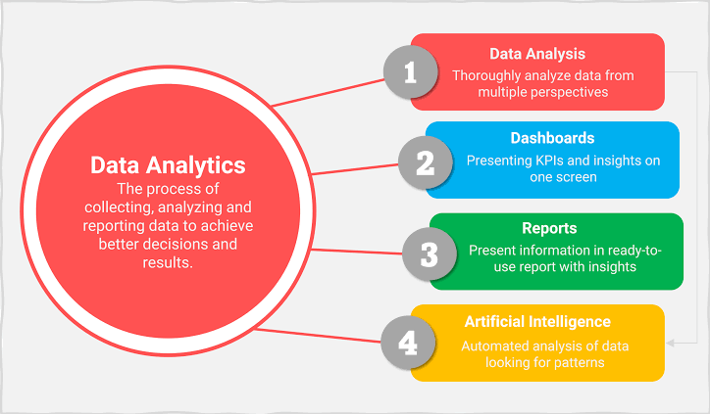

WHO ARE THE END USERS?

Slide 7

OUR SOLUTION AND ITS VALUE PROPOSITION
Conditional formatting: it's used find the missing value
Sort &filter: It is used remove missing value and to fill it.
IPS: This formula is used for multiple condition And to rate the employee performance through this formula
Pivot table: It is used to summarize what we have done.
Graph: This is used for visual

Slide 8
Dataset Description
Employee -kaggle
26 features
11 features
Employ Id: Number
Name: Text
Business unit: Text
Employee type: full time, contract, part time
Performance level: Very high, High, Med, Low
Gender: male, female

Slide 9

Dataset Description
Descriptions for each of the columns in the dataset:
Employee ID: Unique identifier for each employee in the organization.
First Name: The first name of the employee.
Gender: A code representing the gender of the employee (e.g. M for Male, F for Female, N for Non-bin
Employee type : A brief description of the employee’s primary job function or role.
Department: The specific business unit or department to which the employee belongs.
Bank: Employee using banks.
Employee type : A brief description of the employee's primary job function or role.
Performance Score: A score indicating the employee's performance level (e.g.. Excellent, Satisfactory.Needs Improvement).
Current Employee Rating: The current rating or evaluation of the employee's overall performance
3/21/2024 Annual Review
9

Slide 10
MODELLING
Collect the data which you are going to use it.
Select the column and fill it with color so it can be identified.
If there is missing number in selected column use conditional formatting To fill it. Click on highlight in that more rules click on blank and choose format and click on the any color that you want to fill on the blanks.
If you want to identify the missing value click on sort filter to remove the blanks it fill the blank. Click on the column which has blank value& click on sort &filter In that click no fill to remove the blank.
10

Slide 11
RESULTS
Gender | (All)
Count of Employee Name | Column Labels
Row Labels | Average | Fully Meets | Poor | Grand Total
IT/IS | 1 | 2 |  | 3
Labour |  |  | 1 | 1
Production |  | 4 |  | 4
Sales | 6 | 5 | 1 | 12
Grand Total | 7 | 11 | 2 | 20

Slide 12
RESULTS
12

Slide 13
RESULTS

Slide 14
conclusion
The "Employee salary Analysis Using Excel" project provides a robust and user- friendly solution for evaluating and managing employee performance. By leveraging Excel's powerful tools such as filtering, pivot tables, charts, and conditional formatting-the project transforms raw performance data into actionable insights. The resulting interactive dashboards and customizable reports empower managers to make data-driven decisions, optimize workforce productivity and foster continuous improvement across the organization. This solution not only streamlines performance management but also offers a cost-effective, scalable approach to enhancing overall organizational efficiency.

